Slide 1

PowerTrack: Smart Inventory and Order Management
Capstone Project Phase A 24-2-R-18
Reema Nasr - 211940952
Amr Kilany - 207112129
Supervisor: Dr. Samah Idrees-Ghazawi

Slide 2
Agenda
Existing Solutions
User Interface
Introduction
Challenges
Conclusion
1
2
3
4
5
6
7
8
9
10
The Problem
Our Solution
UML Diagrams
Testing
Q&A

Slide 3

Introduction
PowerTrack is a tailored application designed for electrical supply stores. It tackles common challenges in the industry by providing streamlined solutions for tracking orders, managing inventory, and monitoring product availability.

Slide 4

The Problem
1
Inventory Chaos
2
Order Confusion
Incorrect stock s, leading to frustrated customers and lost revenue.
Manual order processing leads to delays and errors.
3
Data Silos
4
Inefficient Workflows
Disconnected systems lead to isolated information, hindering data-driven decision-making and impeding overall business growth.
Time-consuming, processes reduce productivity, increase costs, slow down operations, negatively impacting business.

Slide 5

Existing Solutions
Manual Methods
ERP Systems
Electrical rely on paper-based systems to track inventory. These prone to errors, lack real-time data, and limit scalability.
There is a wide range of business management capabilities, including inventory control. However, They require significant investment and implementation time
Inventory Management Software
Specialized platforms Inventory provide barcode scanning, real-time stock updates, and automated reordering. While more affordable and easier to implement than ERP systems, they may lack comprehensive business management functionality.

Slide 6

Our Solution -PowerTrack
Real-time Tracking
1
Get instant inventory and order status updates.
2
Automated Order Processing
PowerTrack automates order processing from capture to delivery, reducing errors and speeding fulfillment.
Comprehensive Reporting Tools
3
Detailed reports provide insights for informed decision-making.
4
Scalability and Flexibility
PowerTrack scales with your growth and adapts to changing needs.
Robust Security Measures
5
Advanced security protocols protect sensitive data.

Slide 7

Challenges
1
Performance and Scalability
2
Seamless Technology Integration
3
Security
Protecting sensitive user data using encryption, JWT-based authentication.
Ensuring fast response times and handling high concurrency, caching, and load balancing across Flask, MongoDB
Enabling smooth communication between React Native, Flask, and MongoDB with robust API design, error handling, and data validation.
4
User Interface (UI) and Experience (UX)
5
Real-Time Data Processing
Designing a well-crafted UI/UX in React Native to cater to multiple user roles with reusable and modular components.
Handling real-time order tracking and inventory updates using React Native, with Flask managing the database queries and pushing updates.

Slide 8

UML Diagrams

Slide 9
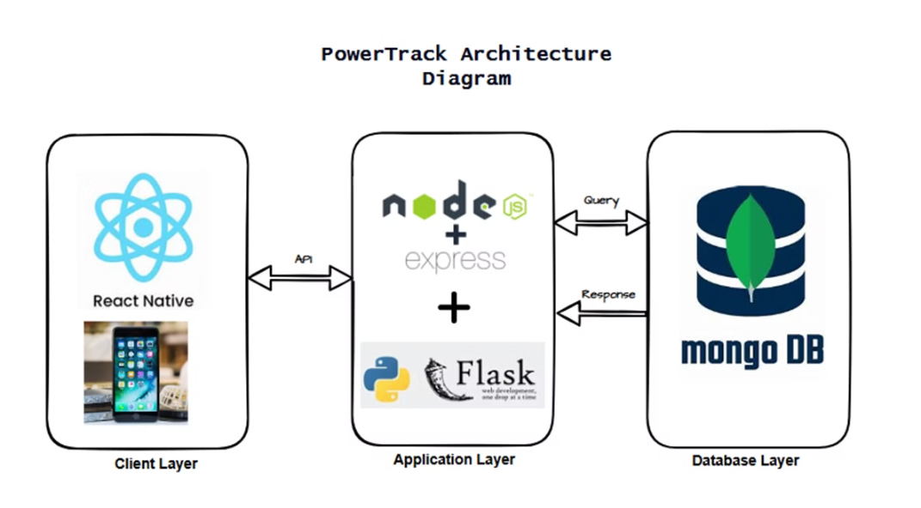
Architecture Diagram

Slide 10
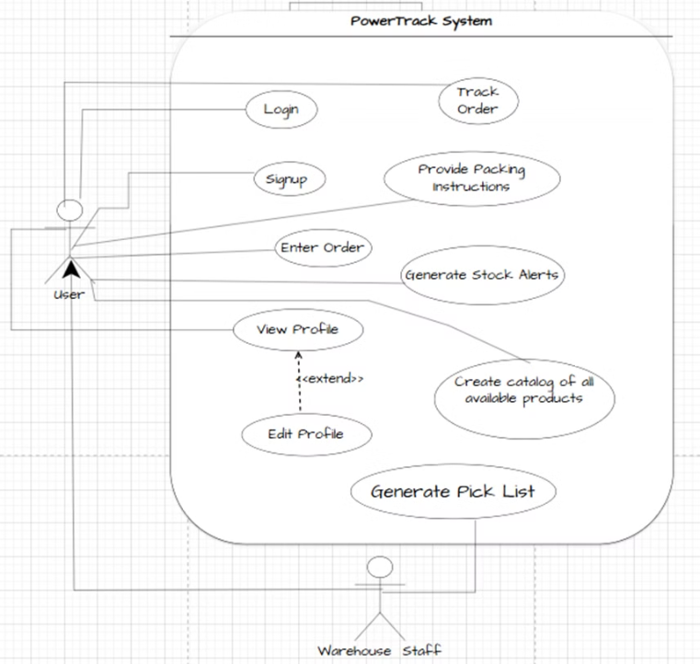
Use Case Diagram

Slide 11
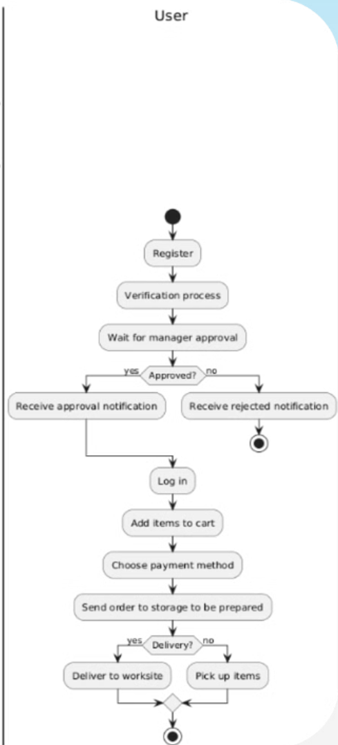
Activity Diagram
User

Slide 12
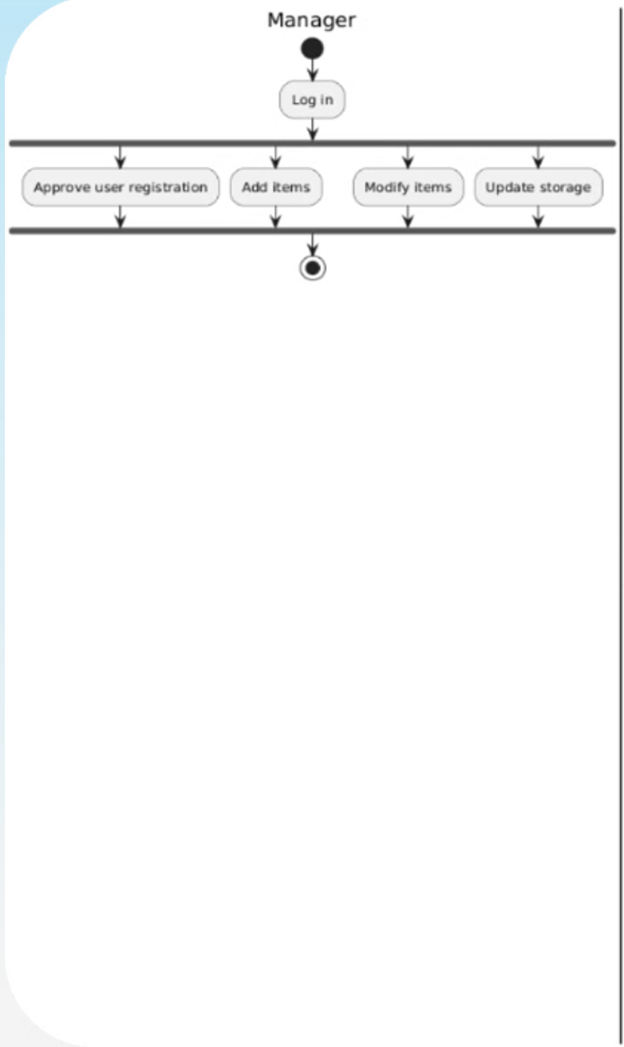
Activity Diagram Manager

Slide 13

User Interface

Slide 14
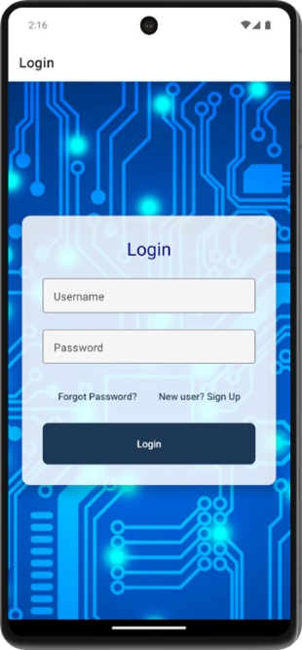
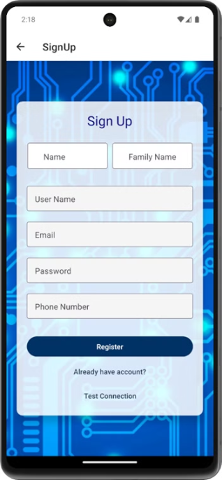
Initial Pages
Login page
SignUp page

Slide 15
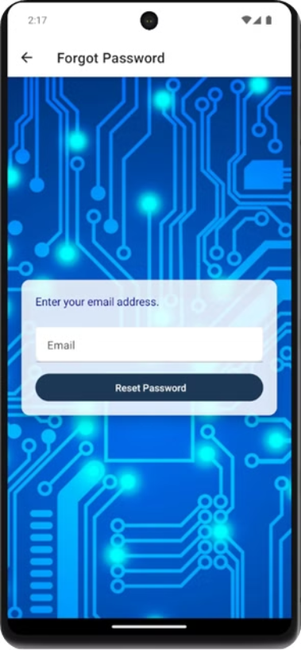
Forget Password Page

Slide 16
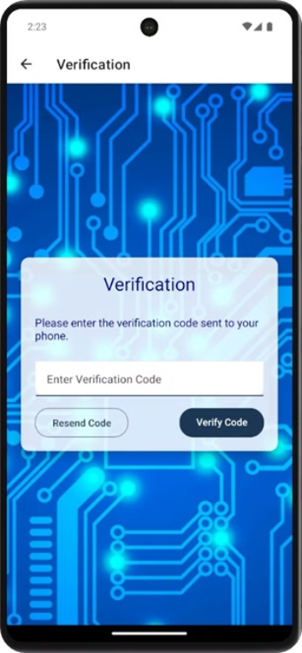
Verification page

Slide 17
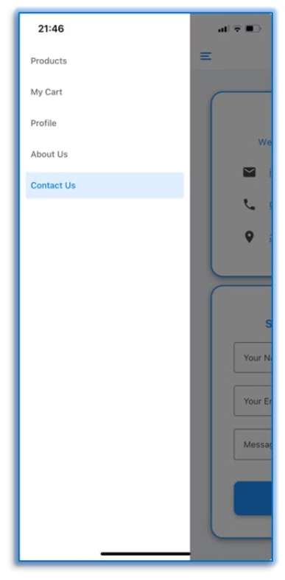
Sidebar on all the pages

Slide 18
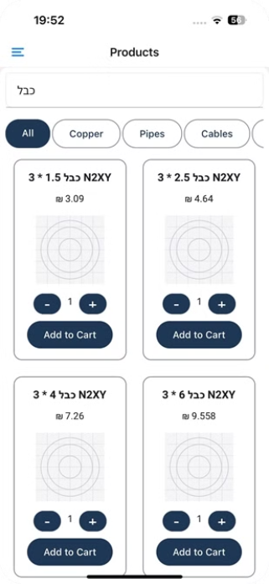
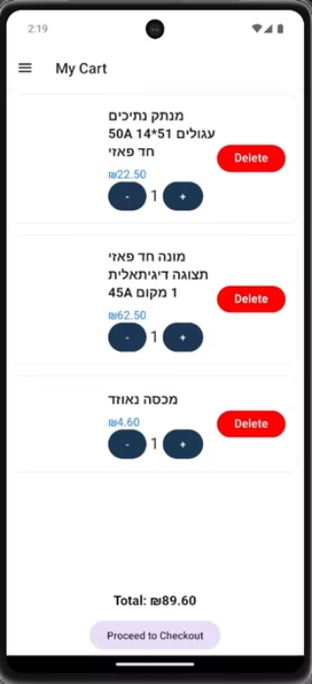
Products Pages
Product Page
MyCart Page

Slide 19
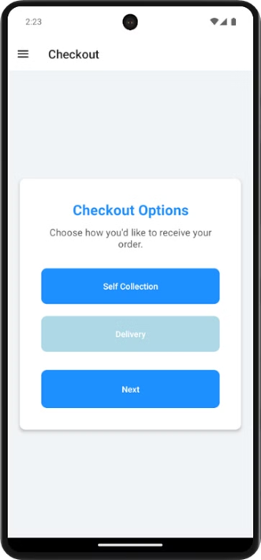
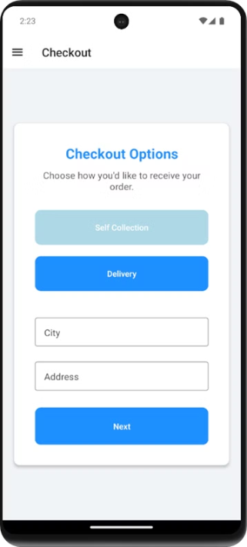
Checkout Page
Select Self Collection option
Select Delivery option

Slide 20
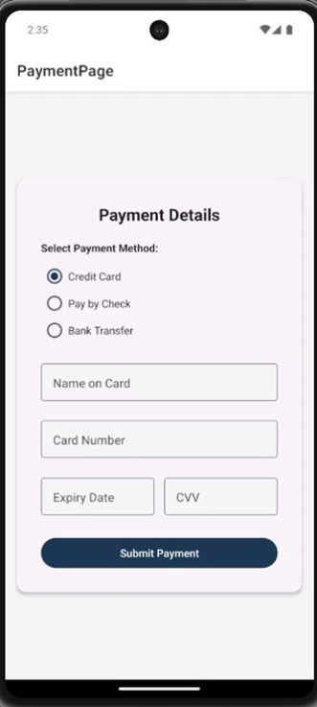
Payment Page

Slide 21
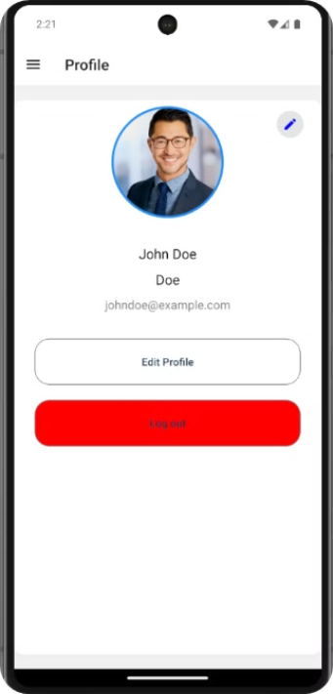
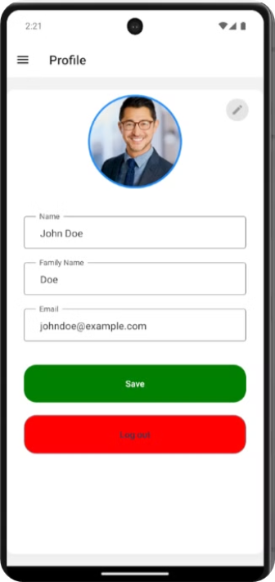
Profile Page
Edit details

Slide 22
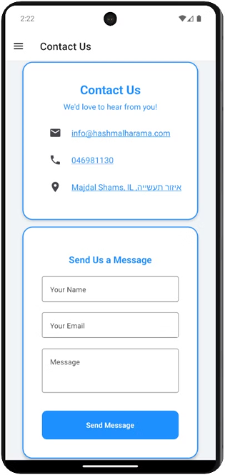
Contact Us Page

Slide 23
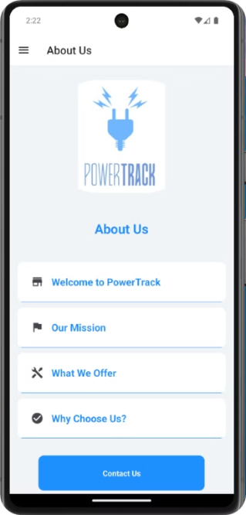
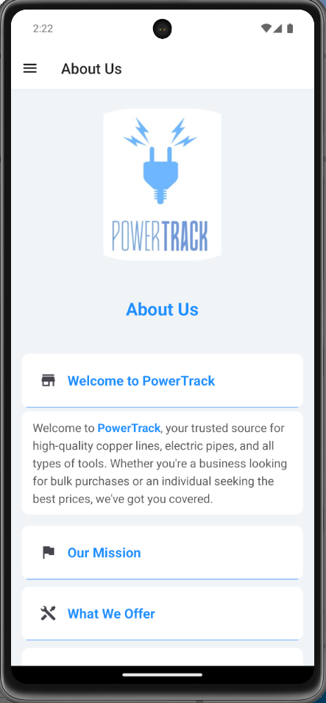
About Us Page

Slide 24
Testing
Test Number
Description
Expected Result
1
Verify the system allows the user to enter new orders into the system.
The user can successfully enter and save new order details into the system.
2
Verify the system allows the user to track the status of orders.
The user can view the status of any order using the order tracking feature.
3
Verify the system allows the user to log in to their account.
The user can log in using valid credentials and gain access to the system.
4
Verify the system allows the user to sign up for a new account.
New users can create an account by providing the necessary information and completing the registration process.
5
Verify the system allows warehouse staff to generate pick lists to prepare orders.
Warehouse staff can generate pick lists for orders to prepare them for shipment.

Slide 25
Testing
Test Number
Description
Expected Result
6
Verify the system allows the user to provide instructions for packing orders.
The user can add specific packing instructions to an order.
7
Verify the system allows customers to select and manage orders for in-store pickup.
Customers can select and manage orders for in-store pickup through the system.
8
Verify the system allows the user to track inventory levels in real-time.
The user can view real-time inventory levels, updated dynamically.
9
Verify the system can generate alerts for low stock levels.
The system sends alerts when inventory levels fall below the specified threshold.

Slide 26

Conclusion
Cost Savings
PowerTrack automates processes and provides real-time visibility, leading to significant cost savings.
Enhanced Customer Experience
PowerTrack provides real-time stock visibility and seamless order fulfillment, helping you consistently meet and exceed customer expectations.
Smoother Operations
PowerTrack automates ordering and inventory management, reducing errors and saving time.

Slide 27


